Slide 1
Alternative Development Model

Slide 2
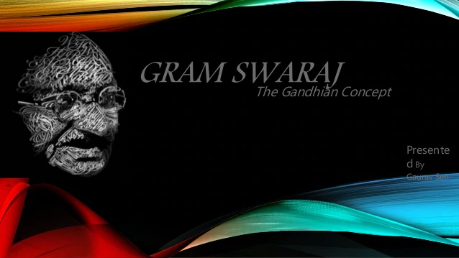

Slide 3
Gram Swaraj - an idea of the self-reliant village is a unique concept of rural reconstruction proposed by Mahatma Gandhi much before India's independence that he developed over a period of times.
His concept of Gram Swaraj is considered one of the alternative models of rural reconstruction, whose primary focus is on the holistic development of a society where individuals are placed in the economic system's centre.

Slide 4
Gram means village and Swaraj is a Vedic word means self-restraint and self-rule.
So, in simple Gram Swaraj, means achieving self-rule and control by the villages.

Slide 5
Thus, in Gram Swaraj, Gandhi focused on the holistic development of individual objectives to attain happiness and harmony at the society. In Gram Swaraj's concept, he thus emphasised economic development and social, cultural and political development of the human being. The principles Gram Swaraj can be summarised as follows.
India lives in its villages, not in cities.

Slide 6
Promotion and use of Swadeshi products
Village industrialisation through small scale and cottage industries.
Each individual must perform their duty towards the state.
Decision making should be lies in people's hand.
Bottom-up Planning Process
Rural Reconstruction is based on the non-exploitation of rural areas.
Moral and ethical values are vital than materialistic gain.
Sarvodaya - the welfare of all

Slide 7
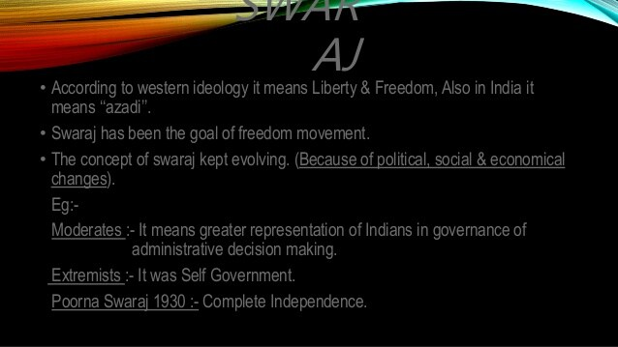

Slide 8
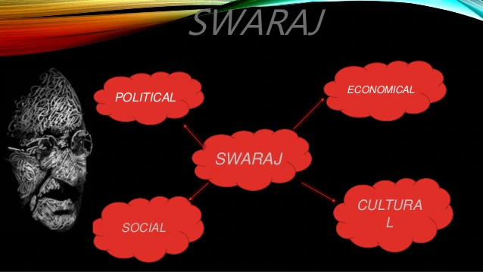

Slide 9
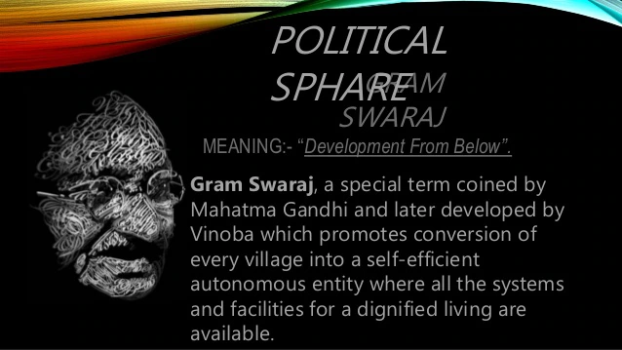

Slide 10
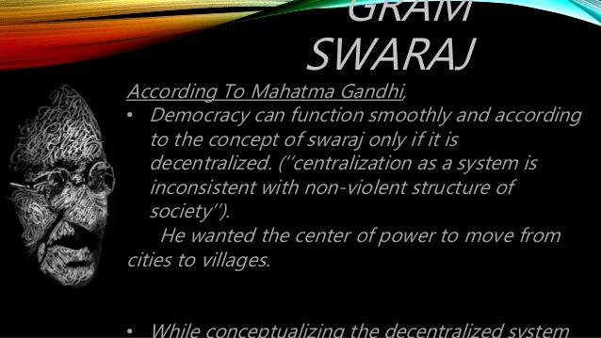

Slide 11
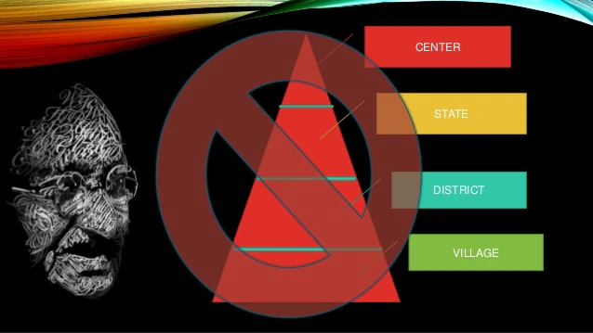

Slide 12
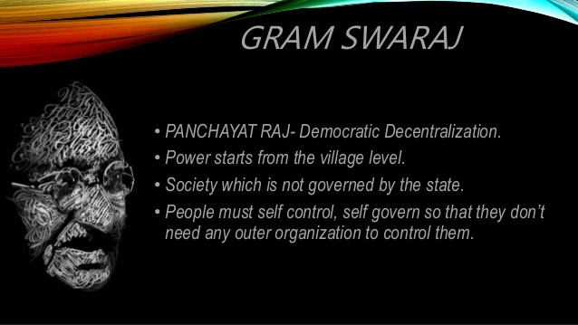

Slide 13
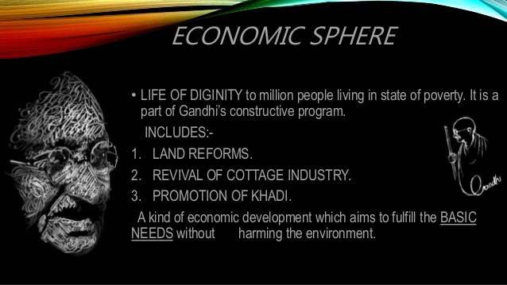

Slide 14


Slide 15
